Slide 1
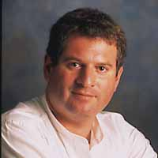
Virtual Facilitation
How do we find our way through the forest of collaboration software on the market?
Daniel Mittleman, Ph.D.
danny@cdm.depaul.edu
College of Computing and Digital Media
DePaul University

Slide 2

Take Aways
A different way of thinking about selection of virtual facilitation tools
Some practical Web2.0 tools to try out

Slide 3
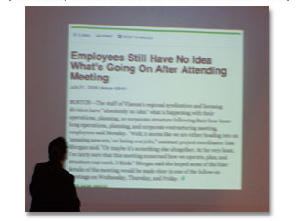
NewsFlash: Virtual meetings are harder to facilitate
Notes:
More and more meetings are going virtual. Whether it is ToP or other faciliation method; whether it is a meeting led by a manager: the skillsets to lead such meetings must be developed.
While there is still much we don’t know about leading virtual meetings we do know this: virtual meetings are harder to facilitate. We also have a pretty good idea why. Divergent ideation activities are easy to do virtually. But convergent negotiation and resolution processes are very tough.

Slide 4

Nobody gets fired for buying Microsoft
We bought MS LiveMeeting for our requirements negotiation meetings
Notes:
I had a student in class Spring of 2007…

Slide 5
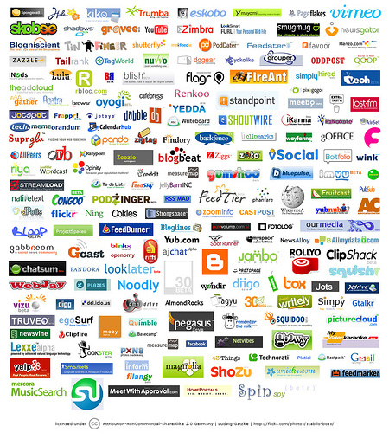















































































































New Web2.0 collaboration tools are…
Falling out of the skies
Notes:
Collaboration tools are falling out of the sky

Slide 6


So, what can we do about this…
How do we improve the process of virtual facilitation?

Slide 7
We notice…
People looking for virtual meeting tools come at it by asking one of three questions…

Slide 8

They have collaboration intention
“My team needs to do a virtual multi-criterion decision process, what should I do?”
Notes:
They have a collaborative intention. That is, they have something they need a team of people to accomplish together. For example, they need to staff a document, make a decision, get a recommendation, solve a problem, get expert input. They want to know how collaboration technologies – that’s how they usually think of it – can help. In fact, what they want to know is: how can a collaboration process supported by collaboration technology help?

Slide 9

They want an affordance
“We need audio conferencing capability, what are my choices?”
Notes:
Or… they know what their intentions are and how they want to go about doing it. What they are searching for is a collaborative capability and want to know what tools are available to them. For example, I need to build a list, I need to store docs, I need jointly edit a document… what are my tool choices?

Slide 10

They jump at the latest trend
“My son says everyone is on Twitter these days. Let’s use that for our meeting.”
Notes:
Or… They have heard about some nifty new groupware and want to know if it will be of value to them. They may have heard about: Wikis, blogs, social networks, google docs, shared graphics, web survey tools, VoIP, NetMeeting tools, or another fairly recent category or product.

Slide 11
Four Entry Points to get to the Solution
Understand
the
Business
Problem
Surface
the
Collaboration
Affordances
Define
the
Technology
Specs
Select
and
Configure
the Product
Execute
Solution
Use Cases
Evaluation Criteria
Groupware Typologies
Evaluate against criteria for relevant use cases

Slide 12
Divergent Process
Convergent Process
Generate
Organize
Reduce
Clarify
Evaluate
Commit

Slide 13
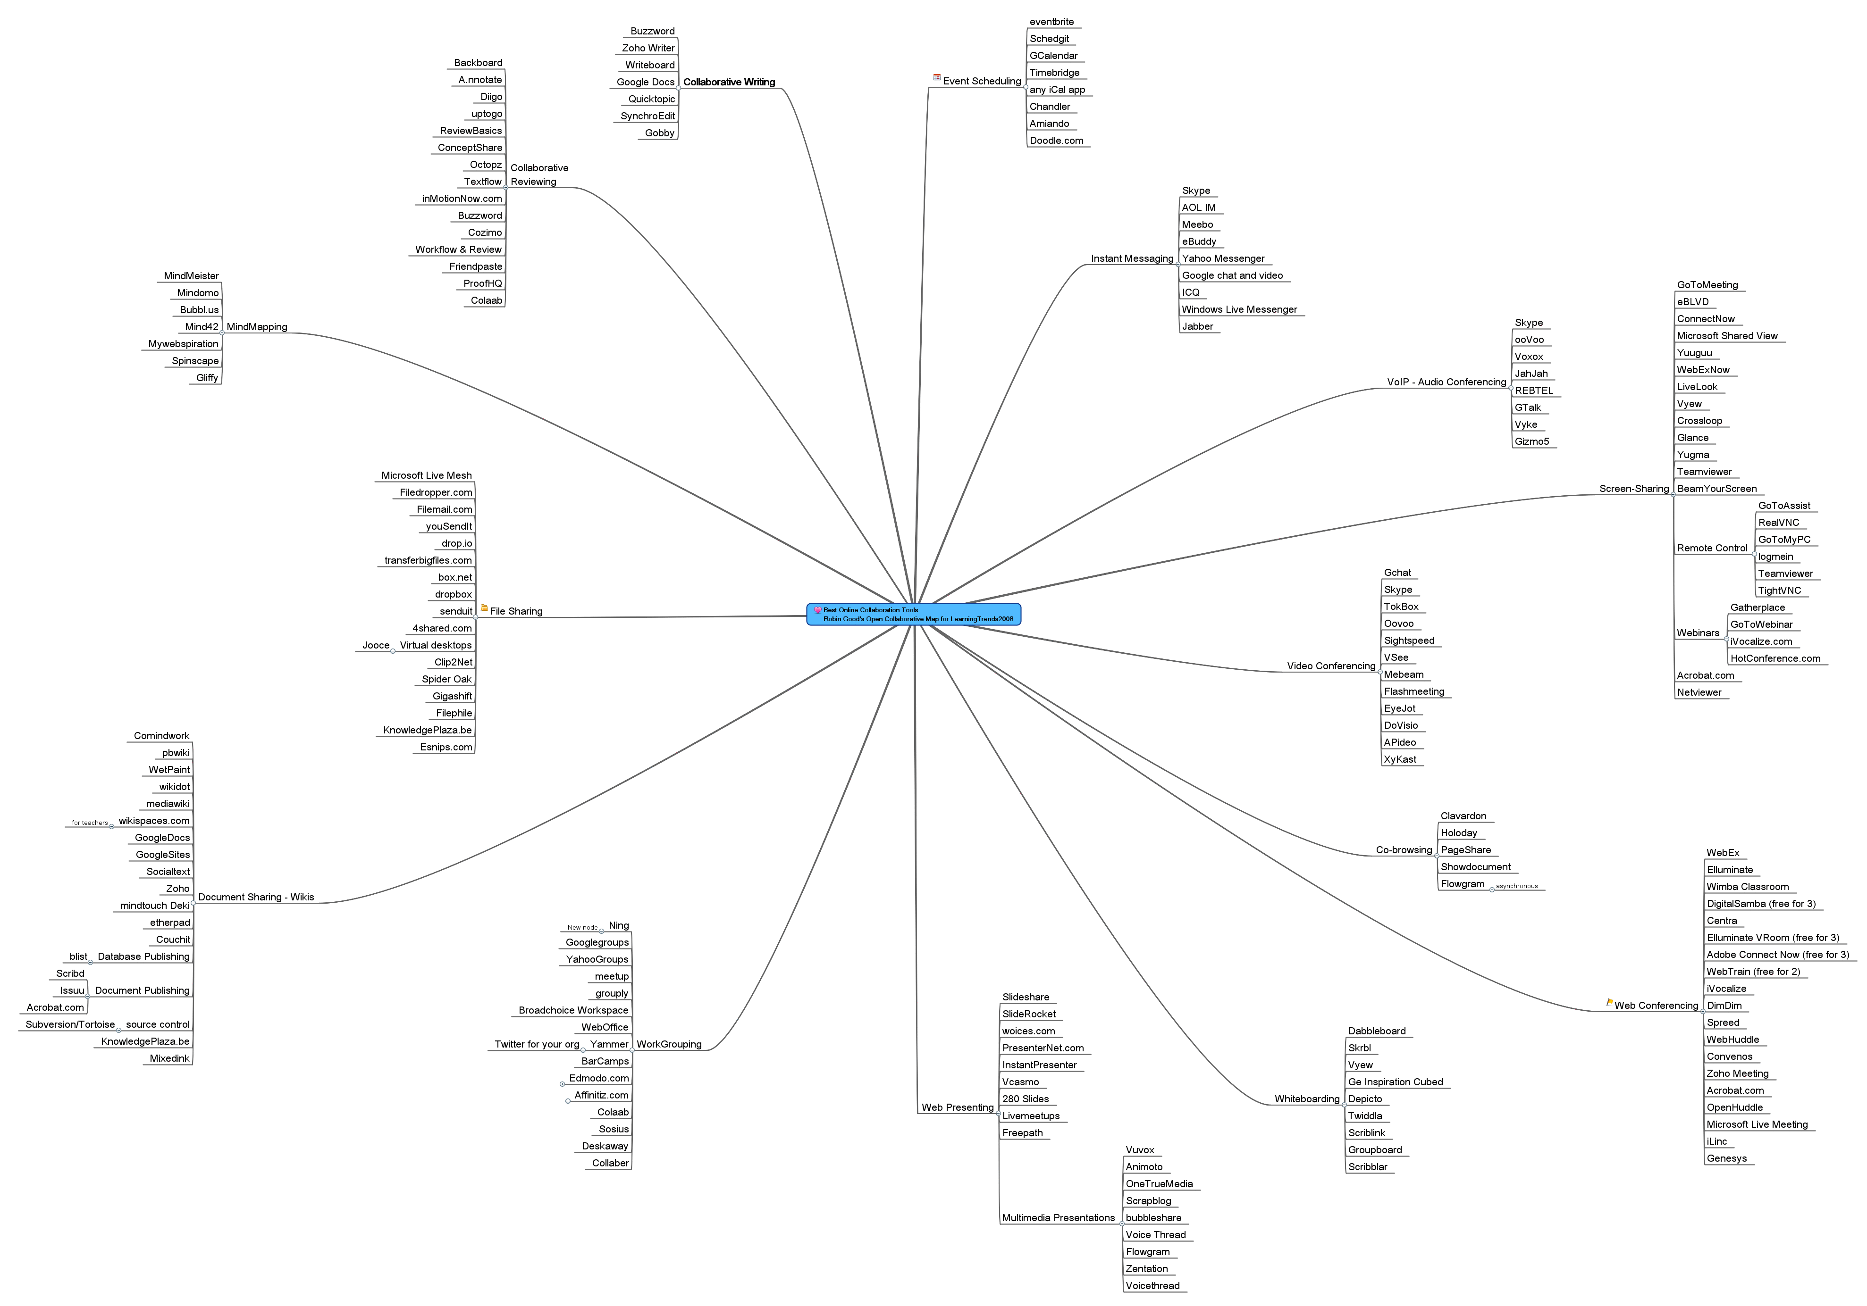
Great MindMeister Tool Map: Here is its shortcoming
It does nothing to differentiate the key affordances within a category in ways that advise you which tool you should use

Slide 14
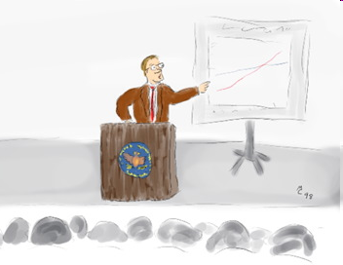
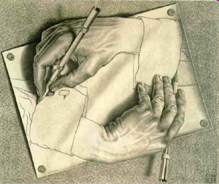
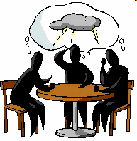
Kinds of processes you want to accomplish at meetings
Briefing
  Presentation
  Training
  Status
Problem Solving
  Ideation
  Knowledge Acquisition
  Knowledge Exposition
  Decision Making
Work Execution
  Group Writing
  Group Modeling
Team Building
  Social
  Celebration
  Values Exploration
Notes:
Many/Most meetings are compound
[this is not a complete list]
Discuss that each type is made up of components… These processes are made up of objects called “thinklets”. And each thnklet has properties and methods. We have about 100 thinklets catalogued – but many more exist most likely.

Slide 15
Kinds of Software you need to use to be successful
Briefing
  Presentation
  Training
  Status
Problem Solving
  Ideation
  Knowledge Acquisition
  Knowledge Exposition
  Decision Making
Work Execution
  Group Writing
  Group Modeling
Team Building
  Social
  Celebration
  Values Exploration
Kinds of processes you want to accomplish at meetings
Tools for briefing online
  Meeting.zoho.com
  Vyew.com
Tools for problem solving online
  Kayuda.com
  mind42.com
  Wridea.com
  FreeMind.com
  surveymonkey.com
Tools for team building online
  Ning.com
  HiveLive.com
Tools for writing online
  Docs.google.com
  Writer.zoho.com
  Wikispaces.com
  Wetpaint.com
Tools for modeling online
  gliffy.com
  flowchart.com
  thinkature.com
  mxgraph.com
  www.editgrid.com
Notes:
Many/Most meetings are compound
[this is not a complete list]
Discuss that each type is made up of components… These processes are made up of objects called “thinklets”. And each thnklet has properties and methods. We have about 100 thinklets catalogued – but many more exist most likely.

Slide 16
Tools for organizing online
  Notebook.zoho.com
  Rememberthemilk.com
Online database tools
  Zoho database
  Quickbase.com
Tools for scheduling online
  Timebridge.com
  AgreeADate.com
  30boxes.com
  Calendarhub.com
  Google calendar
Tools for teaming online
  Huddle.net
  Project.Zoho.com
  WikiSpaces.com
  Grou.ps
  Officezilla.com
All those tools are task focused.
There is a need for process focused tools as well.

Slide 17
Some Dimensions of Differentiating Affordance
Process Channels: How do people communicate process when using the tool?
Interrupts: How do people signal they wish to take control of conversation or product?
Synchronicity & Feedback: How quickly (and how richly) do you receive feedback from teammates? Do you know what work others have done?
Access Control: At what level of granularity can you block out portions of the document to work in? Can you manage ACL by person, by section, by role? How does the software handle contention and conflict?
Shared Focus: how do you focus people’s attention on a particular artifact of interest?
Entry/Exit: How do people get in and catch up to a process?
Archival: How are version histories maintained? How does undo work?
Anonymity and Attribution: How can you handle varying levels of identity in the tool?

Slide 18
Virtual Facilitation
How do we find our way through the forest of collaboration software on the market?
Daniel Mittleman, Ph.D.
danny@cdm.depaul.edu
College of Computing and Digital Media
DePaul University

